Slide 1

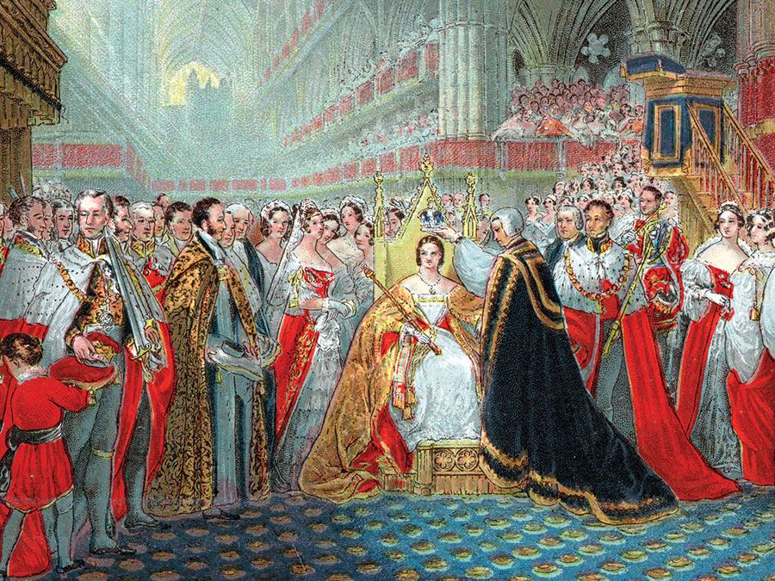
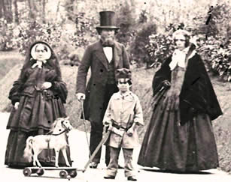
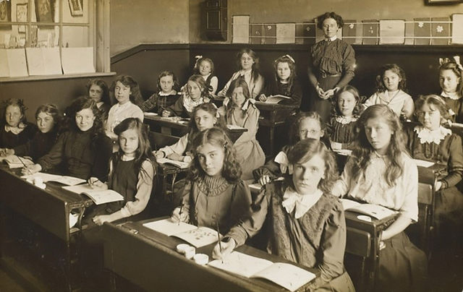
Knowledge Organiser
Victorian History
Key Concepts: Legacy, Monarchy, Justice and Law.
Sticky Knowledge
The Victorian Era is named after Queen Victoria.
The Victorian era dates from 1837 – 1901.
Queen Victoria was the first monarch to live at Buckingham Palace.
Laws were made to stop children from working and provide an education up to the age of thirteen.
Victorian schools were very different to schools today, with children focussing on the 3Rs (arithmetic, reading, writing).
The Victorians were great inventors and made many advances in science and technology.
Thomas Edison invented the light bulb.
Vocabulary
era - a period of time in history
century(19th 20th 21st ) - 100-year period in history
primary source – direct evidence that comes from the time (e.g. artefacts, letters)
secondary source – evidence that does not come from the time (e.g. text books, encyclopaedias)
reign – the period of time for the rule of a King or Queen
monarch – a ruler such as a king or queen
law – the set of rules that people in a society must follow
inventor – someone who makes new things that have never been thought of
advances – steps forward, new ideas
education – the knowledge a person gets through learning

