Slide 1

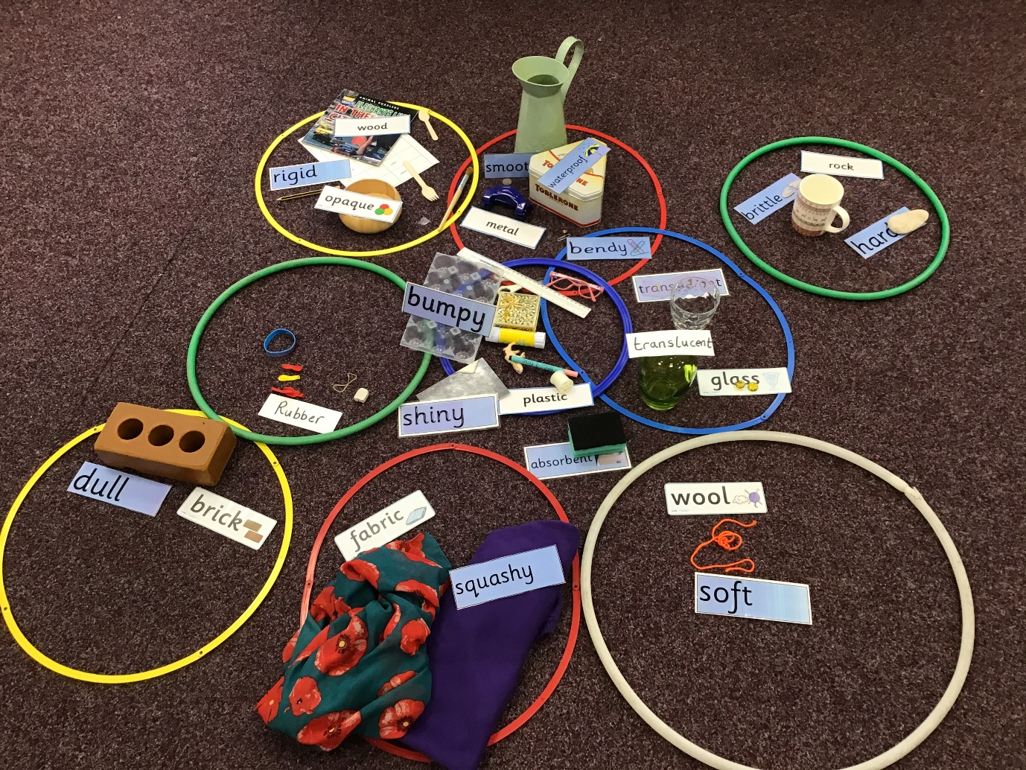
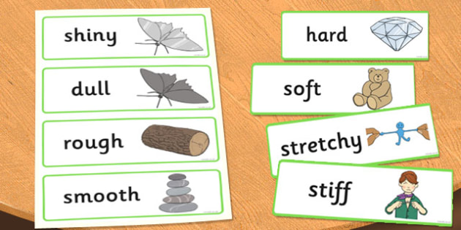
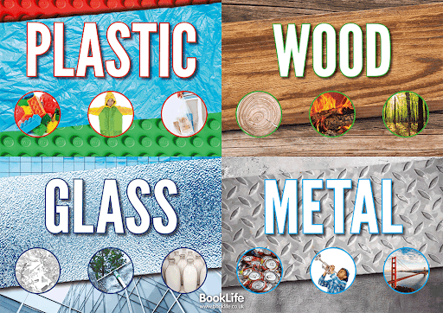
Knowledge Organiser
Uses of Everyday Materials
Key Concepts: Materials, Variables.
Sticky Knowledge
All objects are made of one (or more) materials which have been chosen for their properties.
Materials can be changed by physical force (twisting, bending, squashing and stretching).
A material can be suitable for different purposes and an object can be made of different materials.
Vocabulary
Compress - flatten by pressure due to squeezing or pressing.
Distort – to pull or twist something out of shape to change how it looks.
Opaque – a material that allows no light through.
Transparent- allowing light to pass through so that objects behind can be distinctly/clearly seen.
Translucent - allowing light, but not clear shapes to be seen through it.
Reflective – when light bounces off an object.
Non-reflective – when light does not bounce off an object.
Force – a force is an action such as push, pull or stretch.

